Slide 1
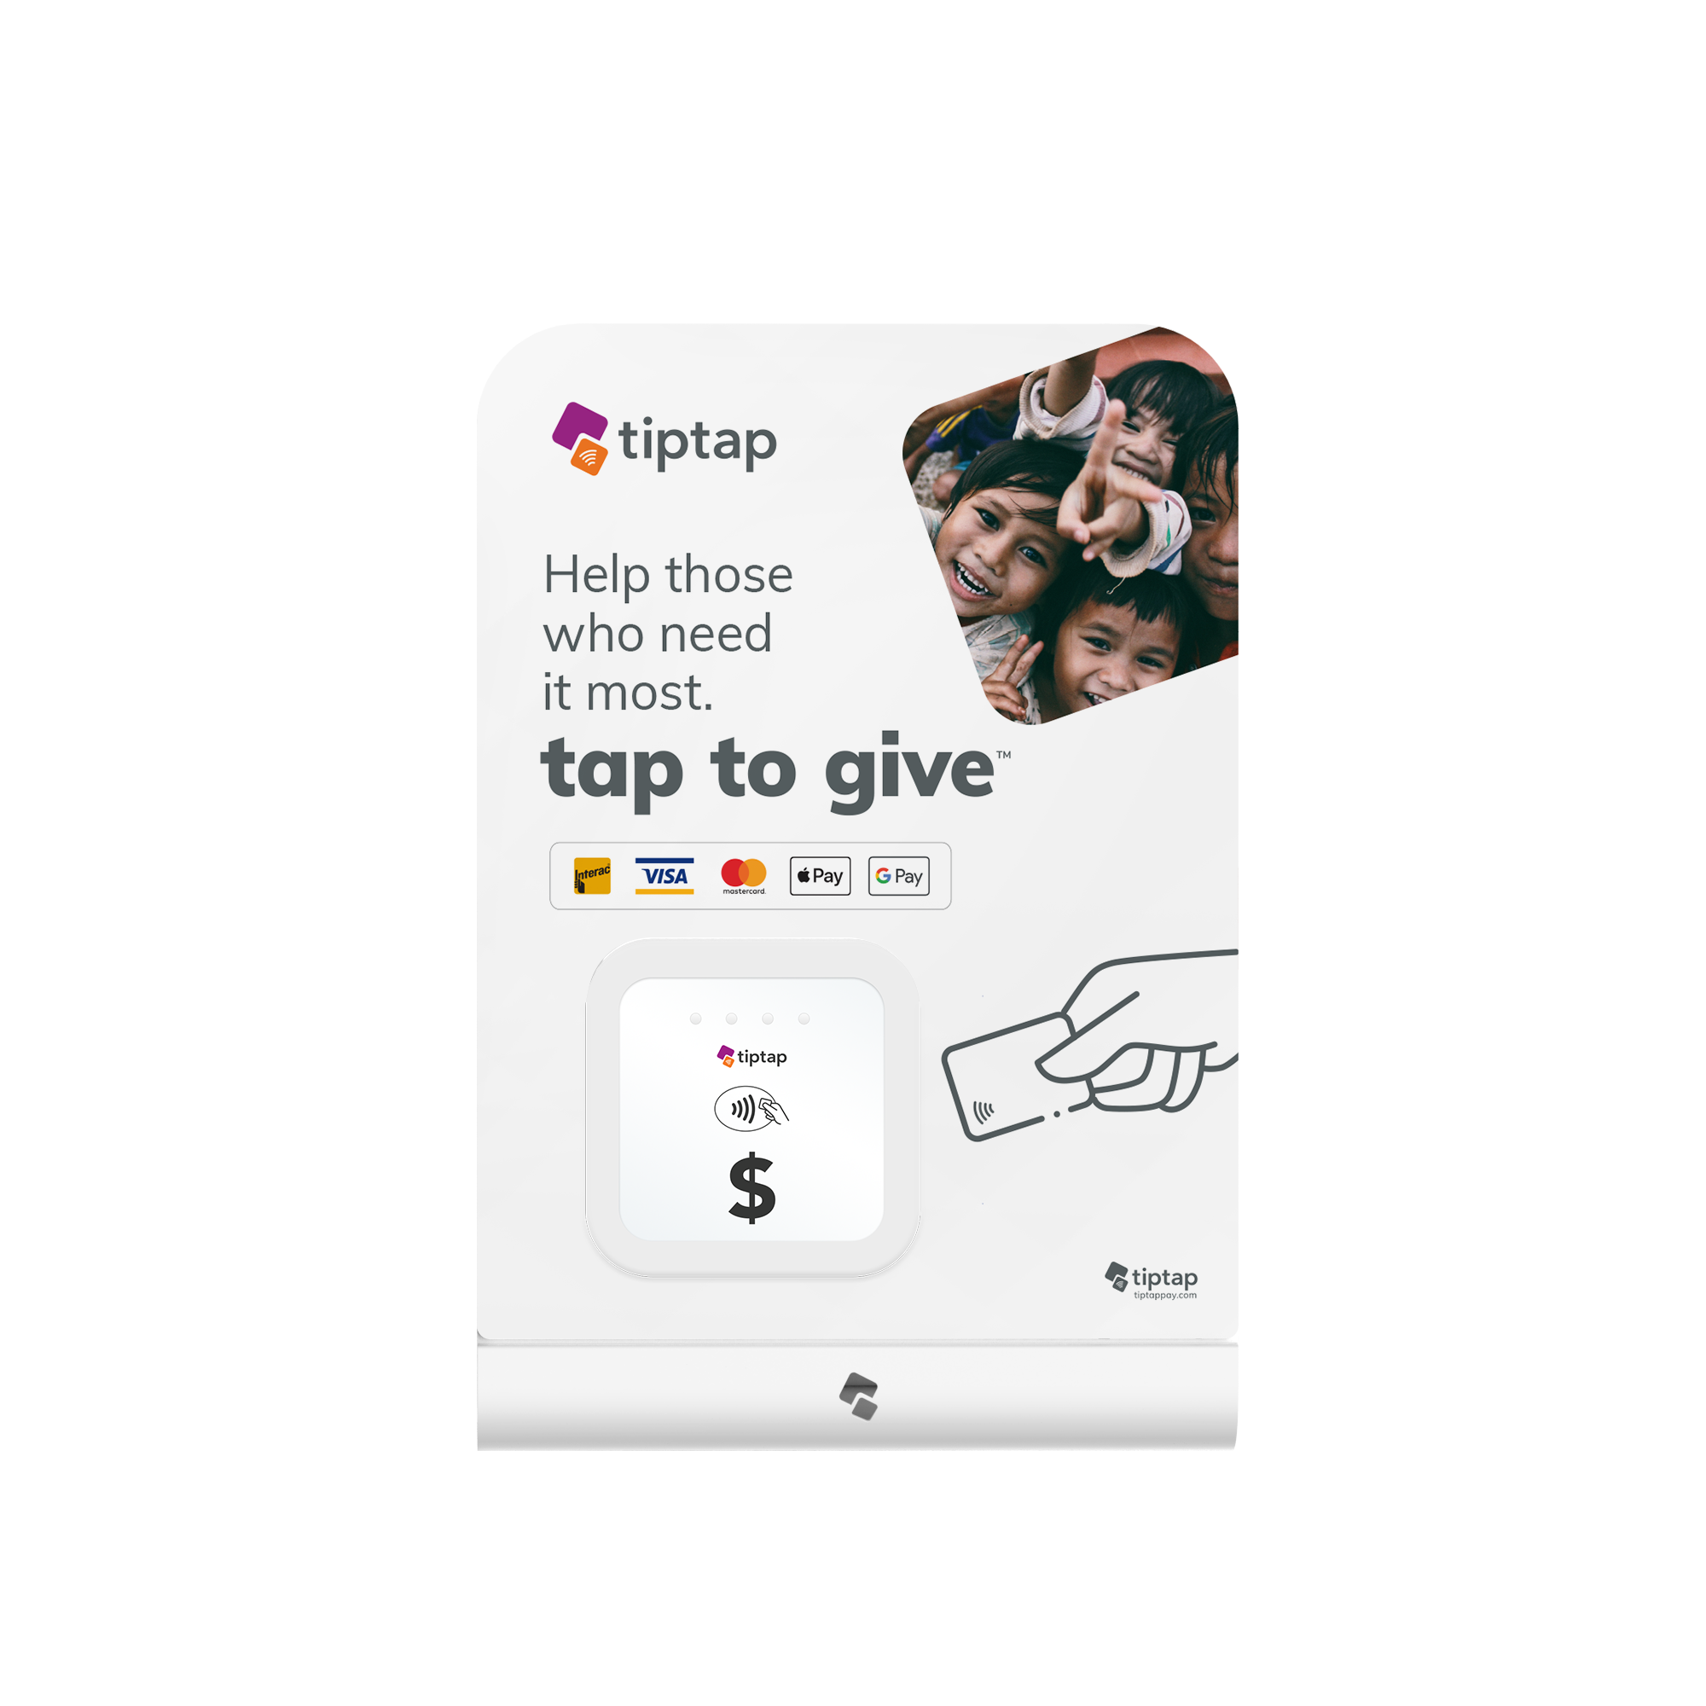
how tiptap will help us collect more

Slide 2
collect more.
do more.
Cash and coin is gone.
A simple tap is all it takes.

Slide 3
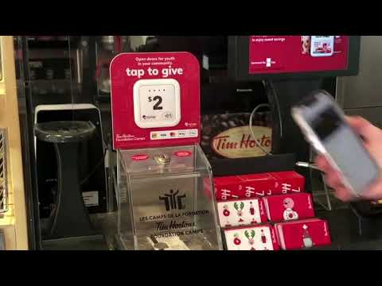

Slide 4
does it work? you bet! On average our customers collect…

Slide 5
simple & effective solutions

Slide 6
how it works: as easy as A...B…C!
A: choose your solution:
counter, floor stand, lanyard, poster, parade bucket
B: customize your sign (optional):
Standard ready-to-tap sign: included
Online design tool (add your logo and tagline): $40
Design your own (user our Adobe Illustrator templates): $0
Let us design and print for you: $105
C: start collecting!
Power up your solution and start collecting!

Slide 7
frequently asked questions
How long will it take to receive my order?
On average, it takes 5-7 business days to receive your order
Is it easy to setup?
Yes! Simply plug-in to a wall outlet or battery and start collecting. No apps, wifi, or setup needed
How do I see results?
View results of your campaign in real-time on your dashboard
Is there a fee per tap?
Yes, 1.5% of transaction per successful tap plus any applicable card fees (typically 3.5% for most cards)
Is there a minimum time commitment?
No, after you purchase, the subscription remains active until you cancel with 30 days notice and return the device(s).
View all FAQs

Slide 8
ready to get started? Visit the online store for product
details and pricing.
shop.tiptappay.com

